Slide 1
iolo technologies Affiliate Program
James D. Nardell
iolo.com Affiliate Management Team
Email: affiliates@iolo.com
Phone: (805) 624-5669
IM – JamesNardell [Skype]
IM – JamesNardell@gmail.com [Google Talk]

Slide 2








iolo technologies and Our Affiliate Program
About iolo technologies
Founded in 1998, iolo technologies, LLC (www.iolo.com) innovates patented technology and award-winning software that repairs, optimizes, and protects computers and digital devices. The company is headquartered in Los Angeles with global sales presence in 33 countries and products in 11 languages. Since 1998 tens of millions of people have used iolo's products for their PC optimization, security, and data recovery needs. Today iolo is widely recognized by both consumers and industry experts as a worldwide leader in the system utility software market.
The company's product line, distinguished by its flagship performance optimization suite System Mechanic®, maintains a reputation of first-to-market technology and differentiated effectiveness. iolo's products are carried in more than 23,000 retail storefronts around the world, including Wal-Mart, Best Buy, Costco, Target, Staples, and Office Depot, and its software can also be purchased from all major e-tailers, as well as a multitude of distributors and resellers in the U.S. and abroad.
iolo's vision is to produce powerful, effective, and sophisticated software that is approachable by both novices and experts, enabling them to enjoy full computing potential by keeping devices running fast, stable, and problem-free. With a significant and growing patent portfolio and ongoing focus on R&D-driven product development, iolo is well positioned to both maintain and grow both its technological and market leadership position.
Awards
Affiliate Program Highlights
Network: Linkshare [US/UK] / CJ / Avangate
Return Days: 45 days
Commission Rate : Up to 70% [Private offer]
Coupons : Multiple coupons available
Exclusive Coupons : Available upon request.
Individual Product Linking (IPL) : Yes
PPC / SEO Keyword Lists : Contact the affiliate manager
HTML Emails For Email Marketers : Contact the affiliate manager
Video For Affiliate Marketing : Contact the affiliate manager
High Quality Content : Contact the affiliate manager
To check out more awards won by iolo Technologies click here.

Slide 3

Affiliate Program Presentation Video
Affiliate Program Presentation Vide
[Please make sure that you are connected to the internet in order to watch this video]

Slide 4
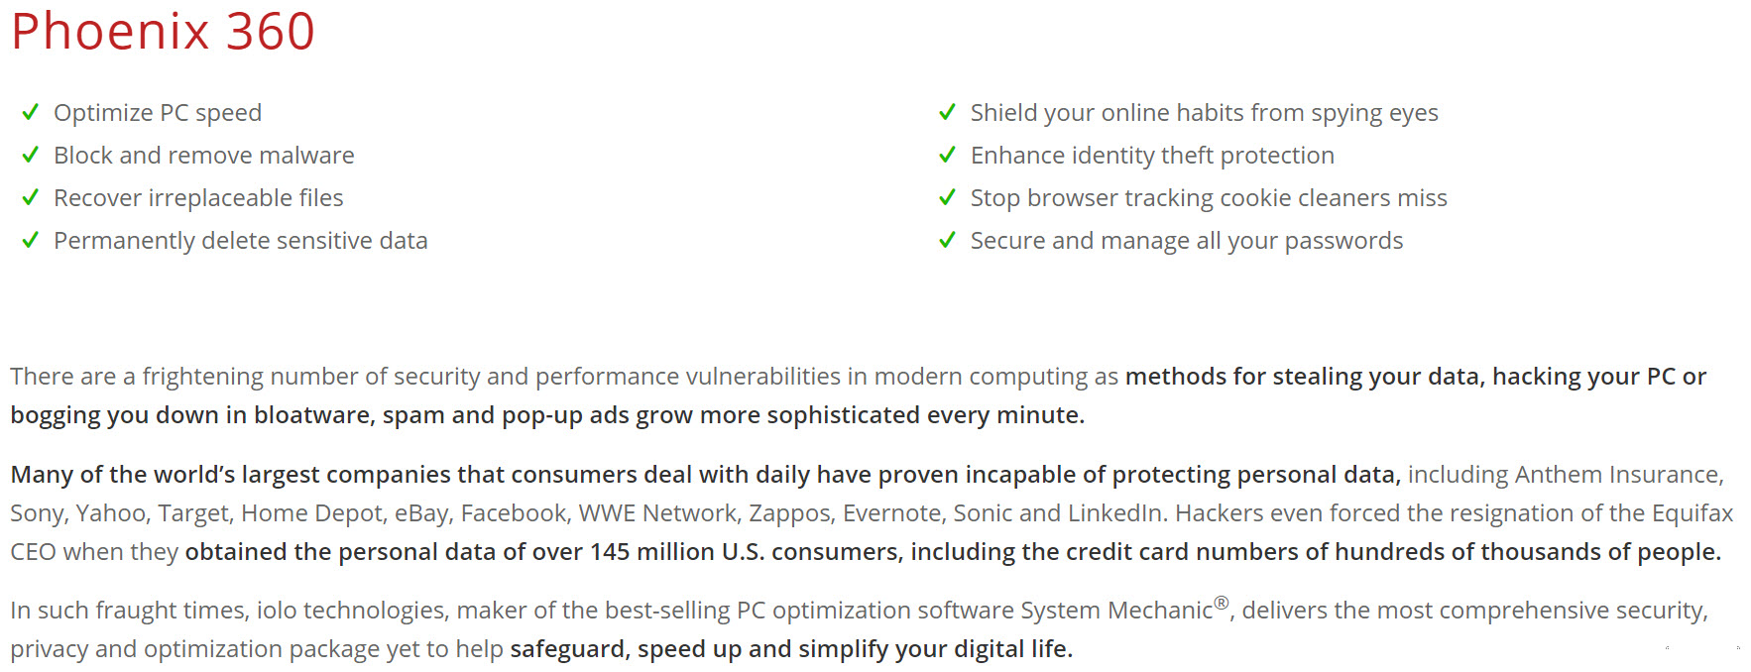
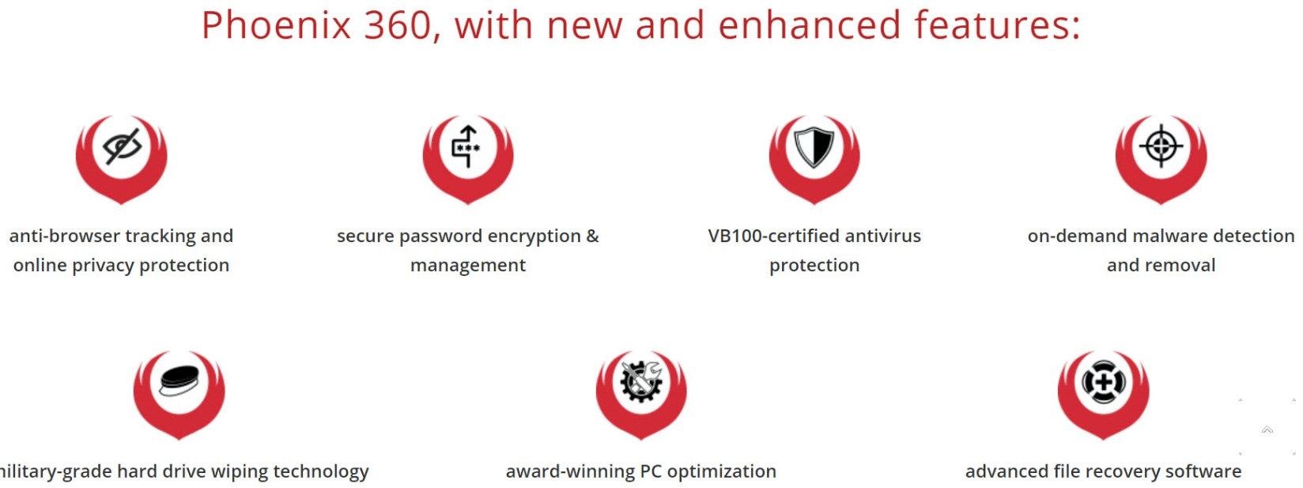
Product Overview: Phoenix 360™
Phoenix 360™

Slide 5

Product Overview: Phoenix 360™
Phoenix 360™

Slide 6
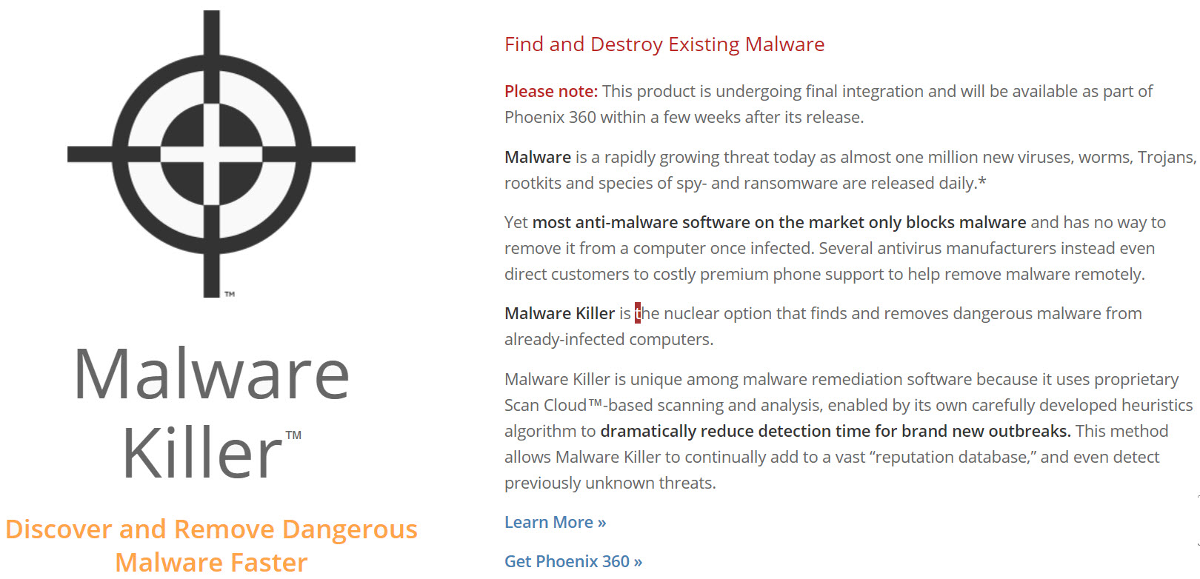
Product Overview: Phoenix 360™
Phoenix 360™

Slide 7

Product Overview: Phoenix 360™
Phoenix 360™

Slide 8

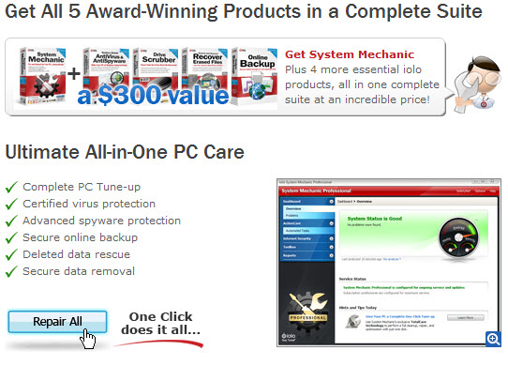
Product Overview: System Mechanic Professional®
System Mechanic Professional®

Slide 9
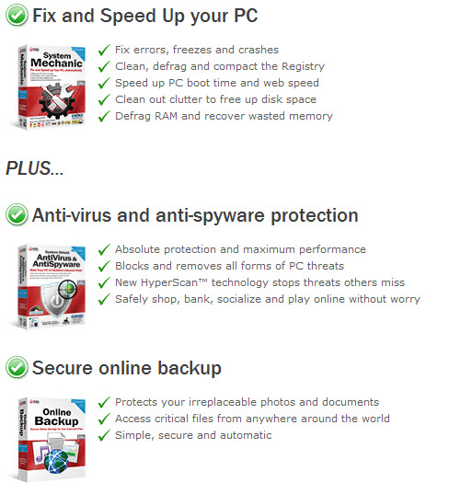
Product Overview: System Mechanic Professional®
System Mechanic Professional®

Slide 10
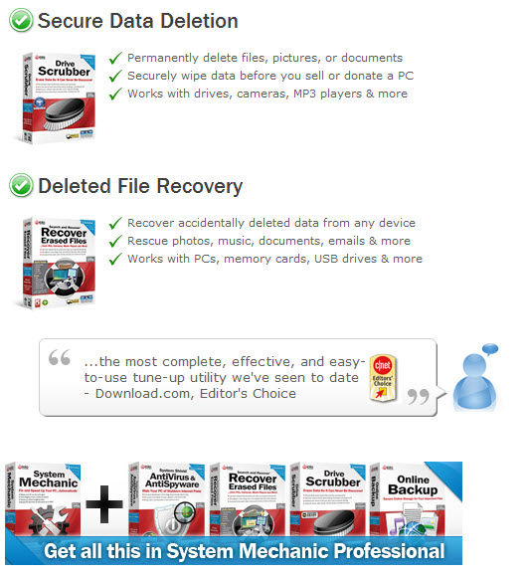
Product Overview: System Mechanic Professional®
System Mechanic Professional®

Slide 11

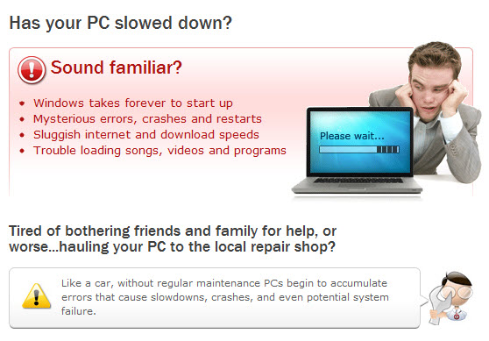
Product Overview: System Mechanic®
System Mechanic®

Slide 12
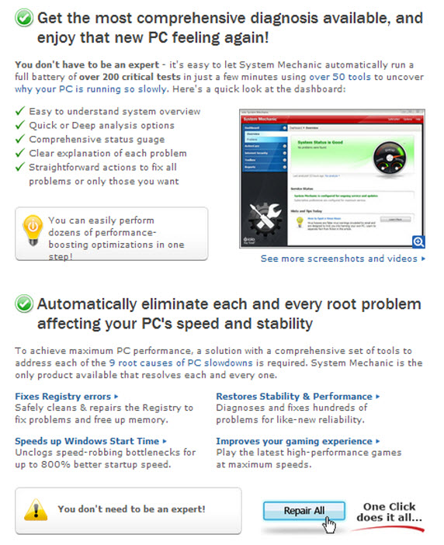
Product Overview: System Mechanic®
System Mechanic®

Slide 13
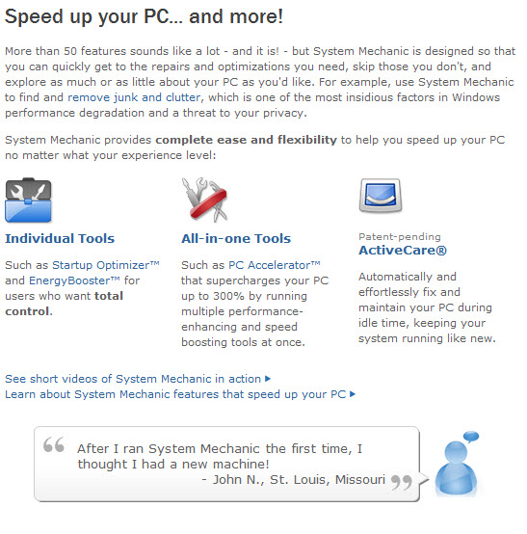
Product Overview: System Mechanic®
System Mechanic®

Slide 14

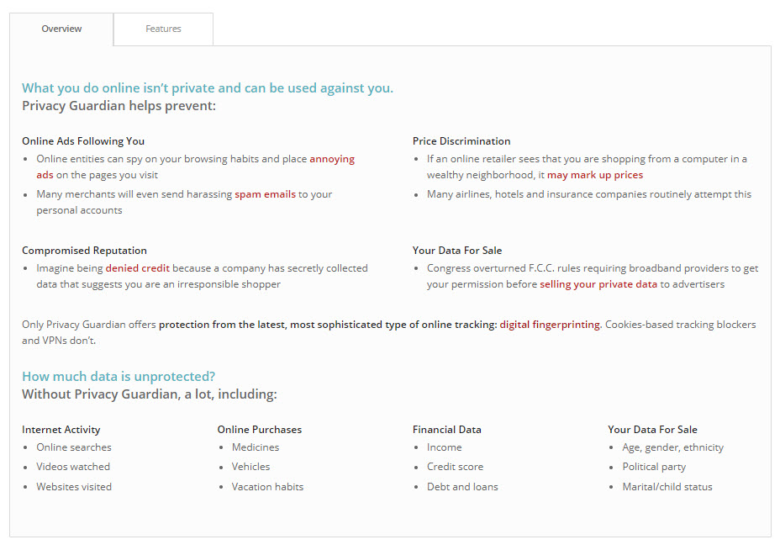
Product Overview: Privacy Guardian™
Privacy Guardian™

Slide 15
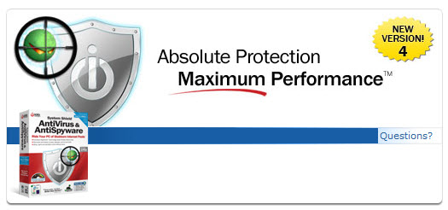
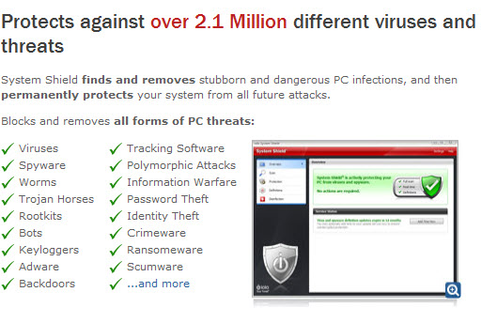
Product Overview: System Shield® 4 AntiVirus and AntiSpyware
System Shield® 4 AntiVirus and AntiSpyware

Slide 16
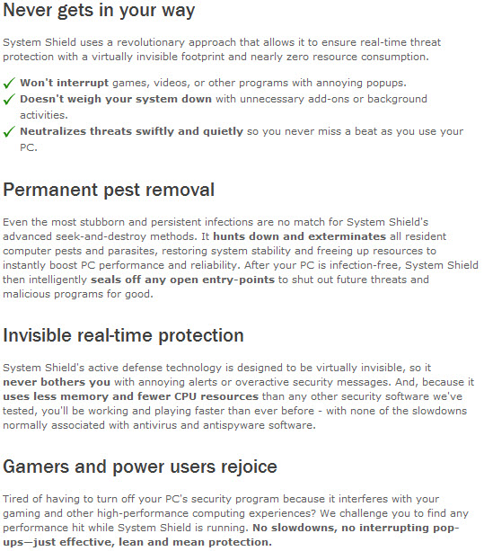
Product Overview: System Shield® 4 AntiVirus and AntiSpyware
System Shield® 4 AntiVirus and AntiSpyware

Slide 17
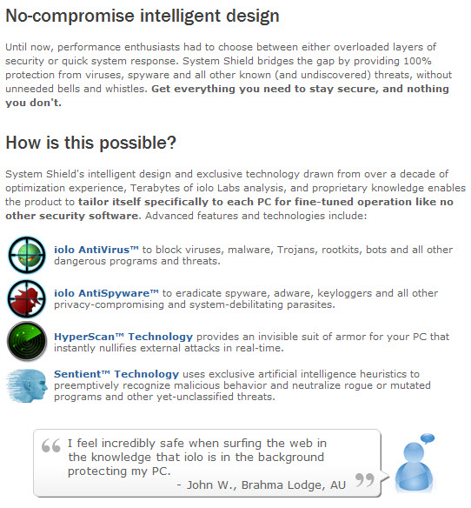
Product Overview: System Shield® 4 AntiVirus and AntiSpyware
System Shield® 4 AntiVirus and AntiSpyware

Slide 18

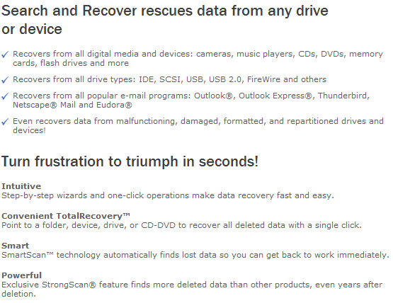
Product Overview: Search and Recover™ 5
Search and Recover™ 5

Slide 19
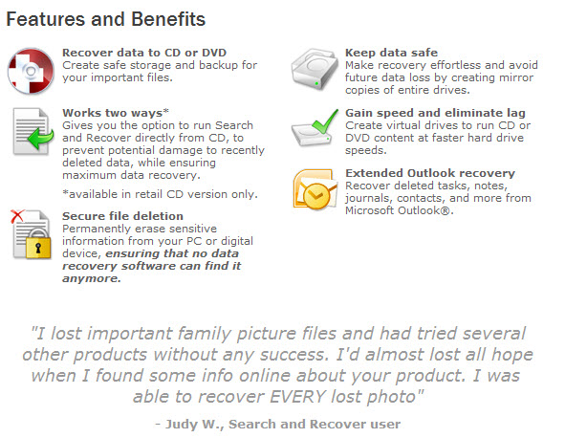
Product Overview: Search and Recover™ 5
Search and Recover™ 5

Slide 20

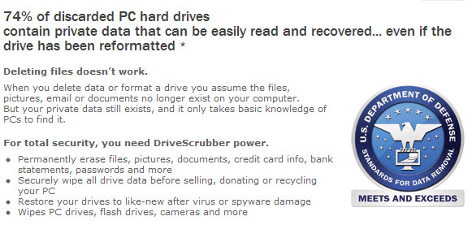
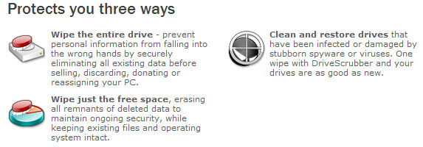
Product Overview: DriveScrubber® 3
DriveScrubber® 3

Slide 21
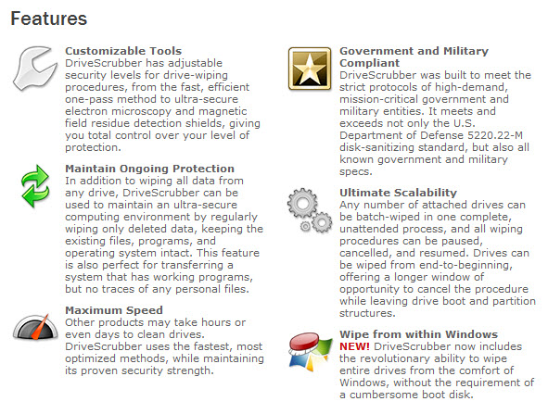
Product Overview: DriveScrubber® 3
DriveScrubber® 3

Slide 22

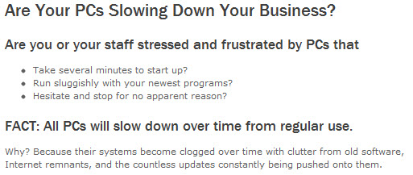
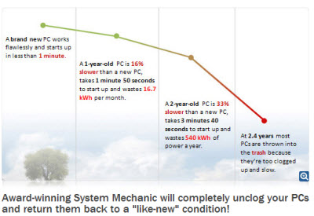
Product Overview: System Mechanic Business
System Mechanic Business

Slide 23





Sample Affiliate Creative
Check out some of our high converting creative…

